Slide 1
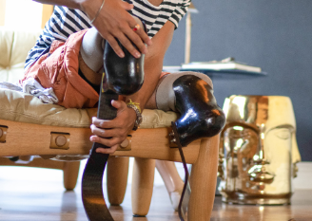
Lower Limb-Loss
By Jagger Gilleland, Zachary Newman, and Quinn Trate

Slide 2
The Patient Journey
Postsurgical stabilization (acute care hospital): postsurgical care is provided to ensure medical stability.
Pre-prosthetic rehabilitation (inpatient rehabilitation/outpatient therapy): independence in mobility and daily activities is achieved with use of assistive devices (e.g., wheelchair or walker for lower limb loss).
Limb healing and maturation (surgeon and Physical Medicine and Rehabilitation clinic visits, outpatient therapy if needed): sutures are removed, scabs resolve, functional evaluation for prosthetic device prescription is completed.
Prosthetic fitting (through O&P clinic): prosthetic device is made and fitted to patient.
Prosthetic rehabilitation (inpatient rehabilitation/outpatient therapy): independence in mobility and daily activities is achieved with use of the prosthetic device.

Slide 3
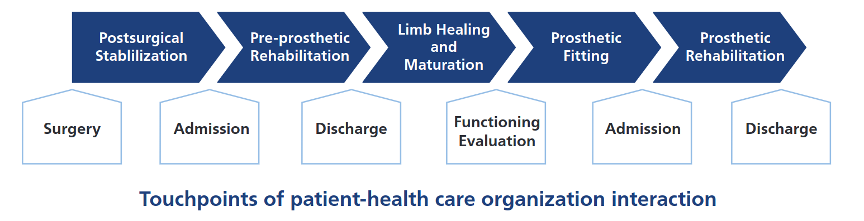
Steps of care delivery for lower limb loss

Slide 4
Function Requirements: Application Format
The system will be a web-based application. The application can be viewed on any web browser, but is primarily meant to be viewed through the associated smartphone app. It is coded in Python using Django framework with SQL integration
The primary development focus will be phone-based. The secondary focus will be desktop-based.
The web application should be able to have an icon on home screens of all smartphones. The icon will open the web browser on the user’s phone to take them to the website.

Slide 5
Functional Requirements: Database
A database connection is used to store the data of patients and recover information.
The web site should be able to securely store user information regarding HIPPA. Users should have access to their personal information when they request it, and healthcare providers can access patient contact information at any time. Providers can use this information to view upcoming appointments or give patients reminders for upcoming appointments. However, providers can only access patients’ medical information when actively with the patient during an appointment.

Slide 6
Functional Requirements: Database (cont.)
Each patient has an account that stores their personal information, which includes the patient’s name, (internal) patient’s ID, phone number, email address, login credentials, and next appointment. The account information is stored in a database table labeled “Patients.”
The database also stores information related to the patient separately but connected to the account. This information includes patient response information, prosthesis sensor data, appointment details, medical providers, and additional related information.
Information entered should be kept for at least a year, possibly up to 10 years for research purposes.

Slide 7
Function Requirements: User Login
Users will login to verify their identity and if they are a patient or a provider.
Users can enter their email and password if they have an account. This will log them in and redirect them to either the patient home page or provider home page depending on which user logged in.
If users do not have an account, they will have an option to make one. Users will need to enter their name, email, phone number and create a password and repeat the password. If the passwords do not match, the user will receive an error message which will prompt them to re-enter the account information. They will also need to select if they are a patient or a provider.
If the user is logging in and the email and/or password is incorrect, a message will pop up to tell them to re-enter the email and password.

Slide 8
Functional Requirements: Application Setup
The web application will be split into two sections.
The first section is for navigation post amputation.
The second section is for visualizing prothesis sensor data.
The navigation section should be split into five steps according to the process. The five steps are: Postsurgical Stabilization (PS), Preprosthetic Rehabilitation (PPR), Limb Healing & Maturation (LHM), Prosthetic Fitting (PF), and Prosthetic Rehabilitation (PR).

Slide 9
Functional Requirements: Application Setup (cont.)
The patient can enter information at each step of the navigation section. This information is the Phantom limb pain scale, Residual limb pain scale, Socket comfort score, and Plus-M for user input. This information will be stored in the “Patient Entries” database table.
The provider should be able to enter the following information into the web portal for a given patient: AmpPro, AmpNoPro, Timed Up and Go, and a 6-minute walk test. This information will be stored in the provider entries in the database table tables.
The information entered should be able to be graphed over a period such that healthcare providers can view it. Time scales for the graph are monthly, three months, six months, one year, and two years.

Slide 10
Functional Requirements: Application Setup (cont.)
Each step should also include pertinent information regarding appointments with doctors and other providers such as the time, date, location, and the Heathcare team. This information will be obtained from the “Appointments” and “Team Members” database tables.
Providers can schedule the next appointment for a specific patient.
The application should send out reminders to a patient’s device after one week of inactivity.
Users can log out when they are done using the app, but the application will remember their login information if the patient consents.

Slide 11
Function Requirements: Sensor Input
A sensor will be used to gather information about the recovery.
The application should be able to connect through Bluetooth to the sensors being developed by the mechanical engineering capstone group.
The sensor section should be able to store the data from the sensor per day and graph it over selected time periods. The sensor data will be sorted as follows: Cadence (steps/minute), Walking time (minutes and seconds), Distance walked (m), Walking speed (m/s), and Step height (mm). Time Scales for the data are monthly, three months, six months, one year, and two years.

Slide 12
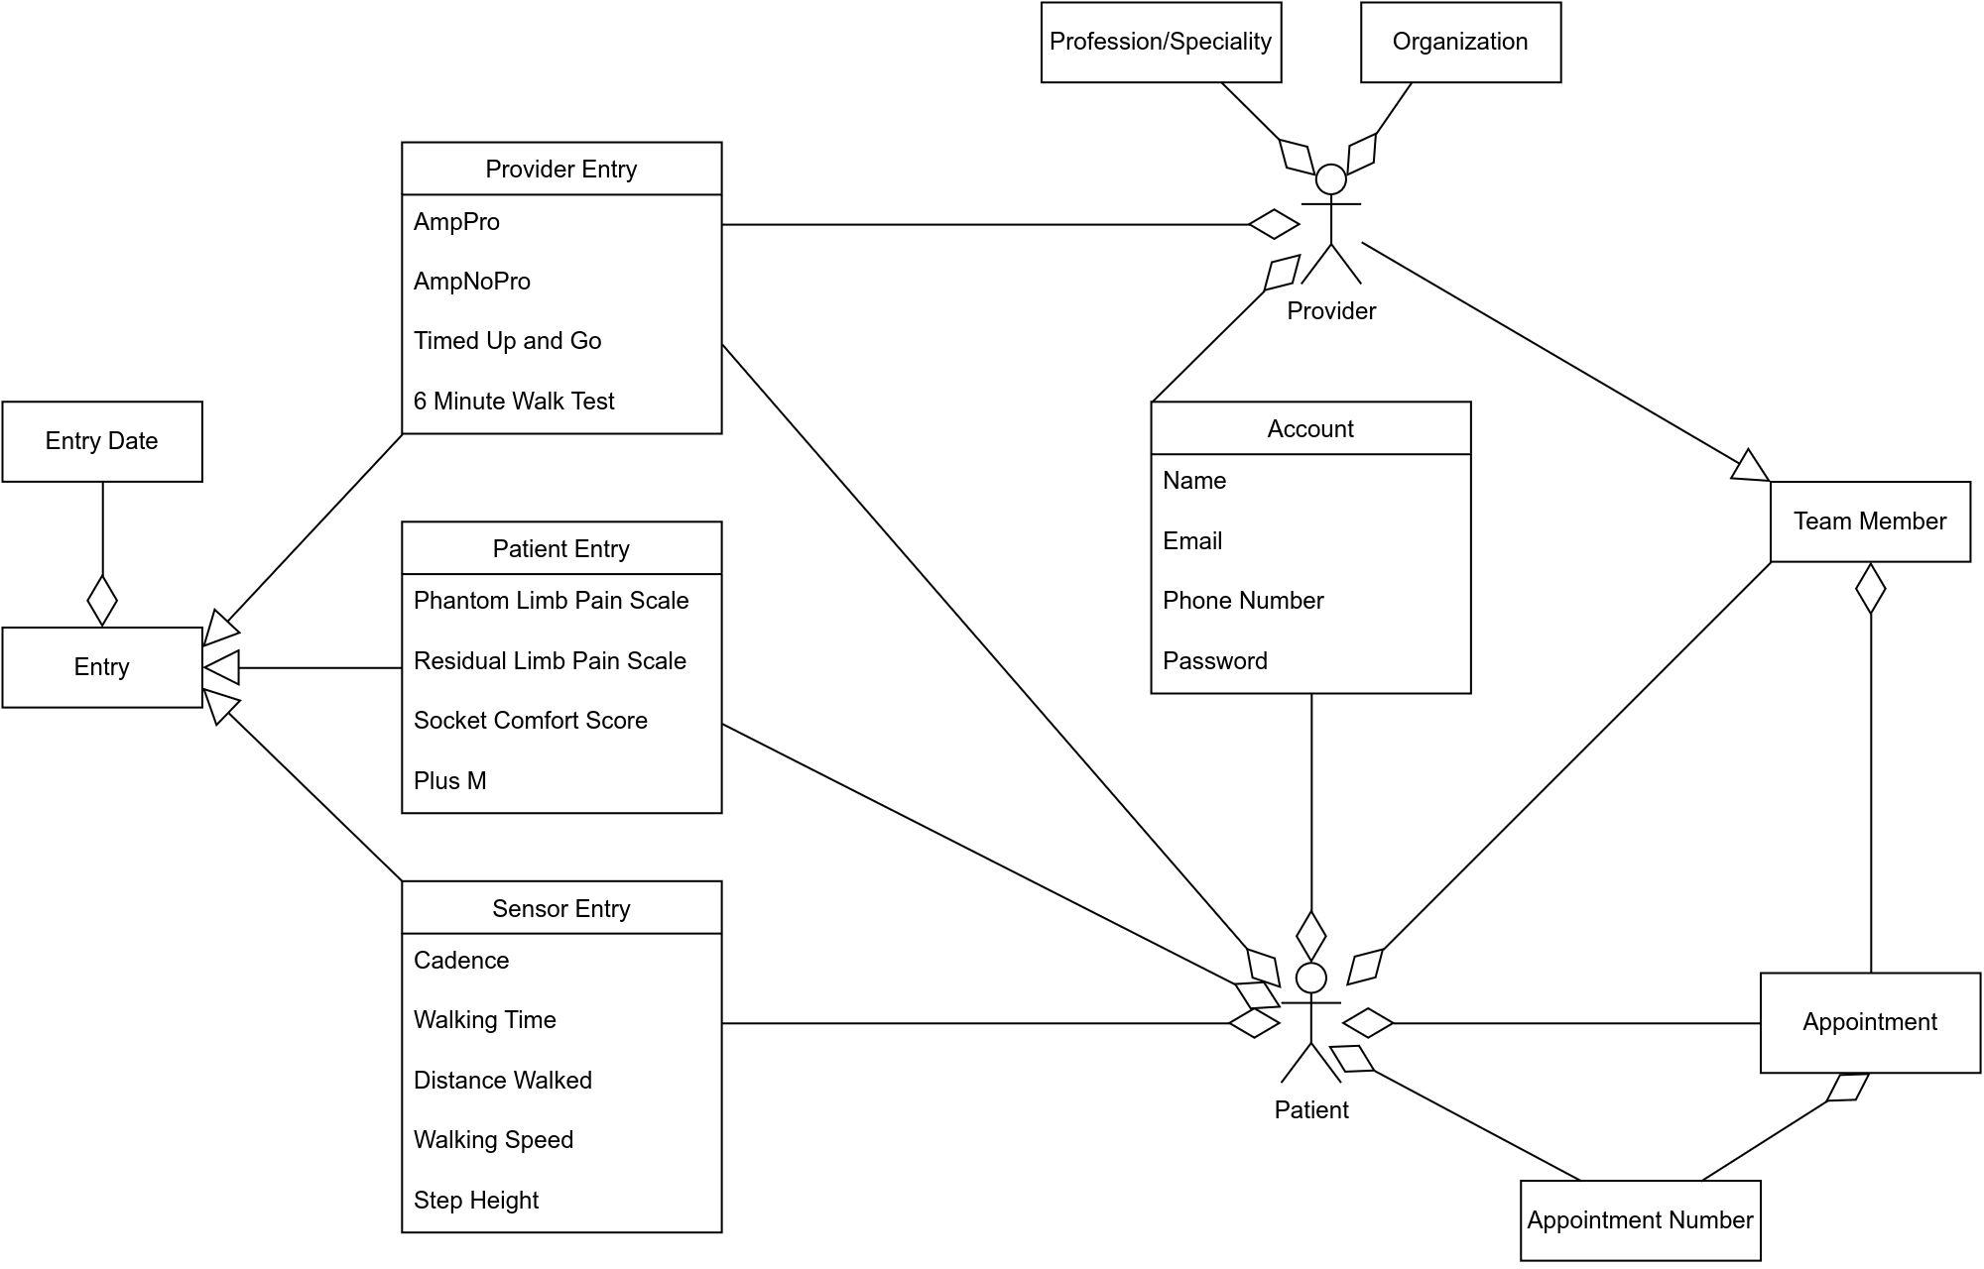
Domain Model

Slide 13
Use Case: User Login
The user clicks the Login button on the Main Page.
The system displays the Login Screen.
The user enters their email address and password, then clicks the Login Button.
The system searches the Patient and Provider tables for the user account with the email address and checks the account password.
If the user is not found, an error will pop up telling them to try again.

Slide 14
Use Case: Patient
Patients can log in or create an account.
Once logged in, the patient will be sent to the patient home screen, where they can view past data as well as time points.
The past data is information for the Phantom Limb Pain scale, the Residual Limb Pain scale, and the Socket Comfort score.
For the first three, the system displays a description/prompt and a 0-10 scale. The user selects a value from 0 to 10 and clicks the Submit button.
The system adds the entered information into an entry of the “Patient Entries” table, shows a confirmation message, and displays the Main page.

Slide 15
Use Case: Patient (cont.)
If the patient has already inputted data for that day, the data will be overwritten for that day.
If the patient is not logged in and tries to advance, they are redirected to the home page.

Slide 16
Use Case: Provider
Providers can log in.
Once logged in, the provider will be sent to the provider home screen, where they can view their patients.
Clicking on the patients will allow them to enter data for the patient. This data includes the AmpPro survey, the AmpNoPro survey, Timed Up & Go test, and the 6 Minute Walk test.
Once they are finished, the provider is sent back to the provider home screen.

